Slide 1

EpiCT Games
Requirement
Analysis
IHC - Assignment 2
Video Game Store
André Clérigo, 98485
Cláudio Asensio, 98433
Pedro Rocha, 98256
Lab Class P4

Slide 2
Introduction
Contextualization: EpiCT Games store is an online web store where everyone can buy games in digital or physical format.
In addition, our platform also offers the option to organize gaming events.
Motivation: Due to the lack of user friendly interfaces in small online game stores, we decided to create a store that makes the action of buying games easier. Besides that, gaming is a raising industry therefore it awakened our interest.
Notes:
Interfaces que nao sejam user friendly -> exemplos 2/3

Slide 3
Goals
Offer a large variety of games to all the ages.
Track user’s game collection.
Promote gaming events for the community.
Benefits
Inexpensive way to buy games without leaving your home.
Can be accessed online through any device via web browser.

Slide 4

Personas
Name: João Silva
Age: 17
Family: Son
Job: Student
Background: Spends his free time gaming
Motivation and goals
Get a new game to play

Slide 5

Personas
Name: António Silva
Age: 50
Family: Divorced, father of one son
Job: Electrician
Background: Likes to fix home appliances
Motivation and goals
Make his son happy
Control the type of games his son plays
Notes:
Esta persona foi criada pois tornou obrigatória a pesquisa de jogos por gênero e/ou restrição de idade.
Merge com a outra persona

Slide 6

Personas
Company Name: DreamHack
Founded: 1994
Family: 200 employees
Type of employees: IT, Marketing, etc
Background: Creates games festivals
Motivation and goals
Organize a gaming event
Make sure everyone has a copy of the game

Slide 7
Usage Scenarios
Teen
Father
Company
Regular young gamer that wants to buy a new game with the expectable low effort.
Father choosing and buying a game to offer it to his child that is aged appropriate.
Company that wants to promote a LAN party by making an advertise in the website.
Notes:
Testes -> tarefas explicitas
-> empresa -> evento com data
Concretizar tarefas concretas

Slide 8
Tasks Elicitation
Search for games
Buy games
1
3
Find promotions
Create events
2
4
You can search for games by price range, genre, age restriction, release dates, etc
Buy games and choosing not only from various payment methods, but also from various formats
Find the best deals in the promotions area
Organize events to meet new people and game together
Notes:
Which tasks will become easier? Mainly, promoting gaming events (by companies). At the moment, they are promoted using other platforms that don’t sell games, therefore you can’t check if the users have a certain game to attend the event.
Main Task
Buy a game: Open the page, select the search bar, write the name. If you can´t find it by name, search using the genre/age restriction/price filters and then select the wished game. After that, complete the payment process. Finally, either get the key or wait for the package to get to your home. Play and enjoy! :)

Slide 9
Requirements
Non-functional
Functional
Intuitive and responsive interface
Buy/search games
Design and system maintenance
Promote events
Notes:
Design and System Maintenance -> Mudar layouts para black friday, natal, ano novo chinês, entre outros. Manutenções de segurança, atualizações, etc.
Intuitive and responsive interface -> Ser fácil entender onde está o nosso objetivo e, ao aceder a uma página, ela ser rapidamente carregada (dentro do normal)
Adicionar security (non-functional)

Slide 10
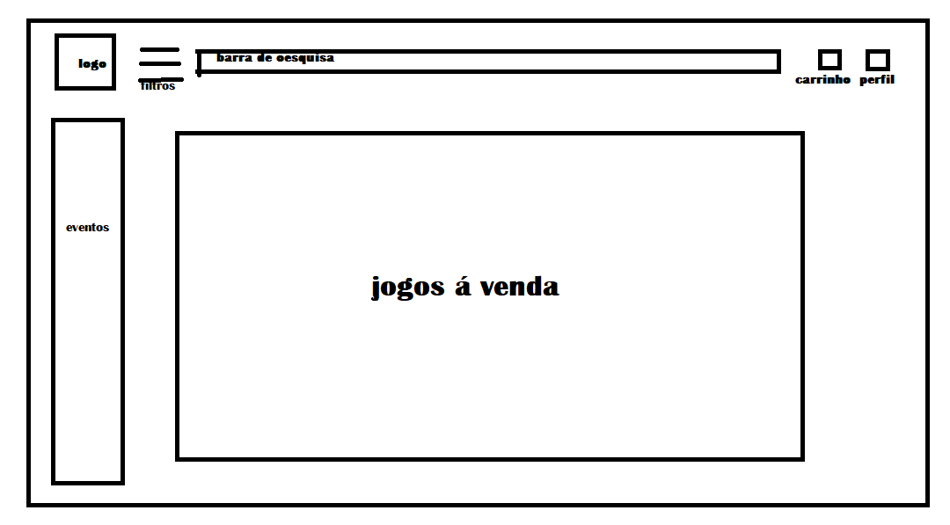
Next Steps
Prototype TBA
Paper Prototype
Test
Give a task to a random user similar to a persona and get his feedback for each step

